Slide 1
Software testing
Micu Victor-Tudor
Ratiu Alexandru-Stefan
Tufescu Mihai-Alin

Slide 2
Types of Tests
Unit Tests: Each method is tested in isolation by mocking dependencies (no database connection).
Behavioral Coverage:
Response status codes
Output content (JSON)
Input validation
PSR-7 compliance
Equivalence Partitioning:
Inputs are divided into valid and invalid equivalence classes
Allows for representative testing without checking every possible input
Helps verify how the controller handles boundary and non-conforming data

Slide 3
Boundary Value Tests:
Pattern Validation for License Plate for the valid license plate format using the regular expression /^[A-Z]{1,2}\d{2,3}[A-Z]{1,3}$/, which ensures that inputs are tested against the minimum and maximum number of characters allowed in each section (start letters, digits, and end letters).
For methods like update, getById, and delete, using ID boundaries (min ID = 1, max ID = 100), as well as non-existing IDs (e.g., 0 and 101), simulate edge cases of accessing valid vs invalid records. This ensures that the system correctly handles valid IDs (responses 200 OK or 204 No Content) and returns 404 Not Found for invalid IDs.
Structural Testing:
A detailed Control Flow Graph (CFG) was created for all controller logic (create, getById, update, delete).
Cyclomatic Complexity = 12, indicating 12 independent execution paths through the controller.
Ensures:
All branches, conditions, and response codes are exercised
Test coverage across normal, error, and edge paths

Slide 4
Unit Tests
Test 2: testCreateReturnsCreated
Purpose:
Tests if VehicleController::create() validates input and creates a vehicle successfully.
Covers:
Controller logic for POST /vehicles
Input format validation for license plate
PSR-7 response code 201
Mocked call to Vehicle::save()
100% PASS WHEN:
Valid license plate is passed (e.g., B123XYZ)
Controller invokes save() once with correct data
Returns response with status 201 and proper headers
Test 1: testGetAllReturnsVehicles
Purpose:
Tests if VehicleController::getAll() returns all vehicles in proper JSON format with status 200.
Covers:
Controller logic for GET /vehicles
PSR-7 response structure
Dependency mocking (Vehicle model)
100% PASS WHEN:
Vehicle::all() returns an array
JSON is correctly written to the response body
Status code is 200
Response contains expected vehicle data

Slide 5
Equivalence Classes
Equivalence partitioning (or equivalence classes) is a test design technique where the input data of a program is divided into partitions of valid and invalid data. Each partition represents a set of values that the system is expected to handle in the same way.
Instead of testing every possible input, it is enough to test each partition — assuming it represents the rest.
Create(Request $request, Response $response)
Input | Class Type | Description | Example
$data['numar_inmatriculare'] | Valid | String matching /^[A-Z]{1,2}\d{2,3}[A-Z]{1,3}$/ | B123ABC
 | Invalid | Any string not matching the pattern | 1234BCA, abc123, ""

Slide 6
Update(Request $request, Response $response, $args)
GetById(Request $request, Response $response, $args)
Input | Class Type | Description | Example | Input
$args['id'] | Valid | Existing vehicle ID | 5 | $args['id']
 | Invalid | Non-existing vehicle ID | 999
$data['numar_inmatriculare'] | Valid | String matching regex | CJ123XYZ | $data['numar_inmatriculare']
 | Invalid | String not matching regex | AB-123-CD, ""
Input | Class Type | Description
$args['id'] | Valid | Existing vehicle ID
 | Invalid | Non-existing vehicle ID
Input | Class Type | Description

Slide 7
Boundary Value Tests
Test Case | Input | Expected Result
Minimum valid | B12A | 201 Created
Maximum valid | AB123ABC | 201 Created
Below minimum digits | B1A | 400 Bad Request
Above maximum digits | B1234A | 400 Bad Request
Below min letters start | 1B23C | 400 Bad Request
Above max letters start | ABC123A | 400 Bad Request
Below min letters end | B123 | 400 Bad Request
Above max letters end | B123ABCD | 400 Bad Request
Boundary value tests are a type of black-box testing technique in software testing, focused on identifying errors at the boundaries of input domains rather than within the range.
Create(Request $request, Response $response)
Input: $data['numar_inmatriculare]
Pattern: /^[A-Z]{1,2}\d{2,3}[A-Z]{1,3}$/
Boundaries:
Number of letters at the start: 1 or 2 uppercase letters
Number of digits: 2 or 3 digits
Number of letters at the end: 1 to 3 uppercase letters

Slide 8
Update(Request $request, Response $response, $args)
Input:
$args['id'] (as primary key/identifier)
$data['numar_inmatriculare'] (same pattern as above)
Boundaries:
Minimum valid ID: 1
Non-existing ID: assuming max existing is 100, test with 101
GetById(Request $request, Response $response, $args)
Boundaries:
Existing IDs: 1 to 100
Non-existing: 0 or 101
Test Case | Input ID | numar_inmatriculare | Expected Result
Valid min ID | 1 | B12A | 200 OK
Valid max ID | 100 | AB123ABC | 200 OK
Non-existing below min | 0 | any | 404 Not Found
Non-existing above max | 101 | any | 404 Not Found
Valid min pattern | 1 | B12A | 200 OK
Valid max pattern | 1 | AB123ABC | 200 OK
Invalid pattern | 1 | 1234A | 400 Bad Request
Test Case | Input ID | Expected Result
Existing min ID | 1 | 200 OK
Existing max ID | 100 | 200 OK
Below min | 0 | 404 Not Found
Above max | 101 | 404 Not Found

Slide 9
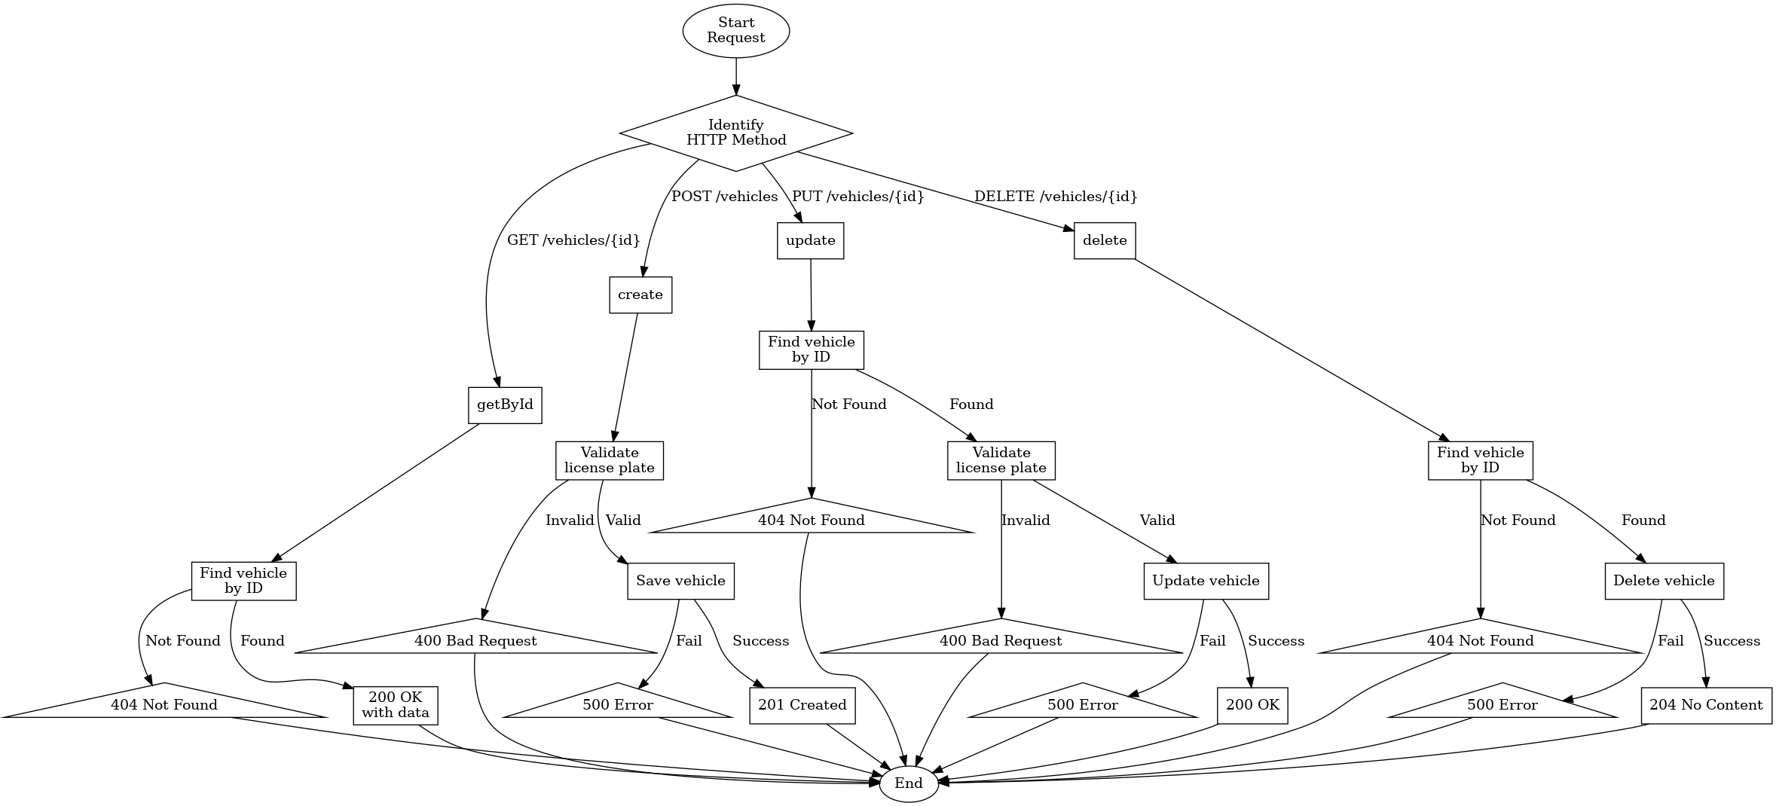
Control Flow Graph
Label | Step Description | Purpose
A | Start Request | Entry-point for every call
B | Identify HTTP Method | Dispatches to the correct handler (GET, POST, PUT, DELETE)
GET /vehicles/{id}
C1 | getById | Controller entry
C2 | Find vehicle by ID | Repository lookup
C3 | 404 Not Found | Vehicle missing
C4 | 200 OK + data | Vehicle found
POST /vehicles
D1 | create | Controller entry
D2 | Validate licence plate | Business rule check
D3 | 400 Bad Request | Plate invalid
D4 | Save vehicle | Persist entity
D5 | 500 Error | DB failure
D6 | 201 Created | Persist succeeded
PUT /vehicles/{id}
E1 | update | Controller entry
E2 | Find vehicle by ID | Repository lookup
E3 | 404 Not Found | Vehicle missing
E4 | Validate licence plate | Business rule check
E5 | 400 Bad Request | Plate invalid
E6 | Update vehicle | Persist changes
E7 | 500 Error | DB failure
E8 | 200 OK | Update succeeded
DELETE /vehicles/{id}
F1 | delete | Controller entry
F2 | Find vehicle by ID | Repository lookup
F3 | 404 Not Found | Vehicle missing
F4 | Delete vehicle | Remove entity
F5 | 500 Error | DB failure
F6 | 204 No Content | Deletion succeeded
Z | End | Unified exit node

Slide 10
Cyclomatic Complexity
Using McCabe’s formula M = E – N + 2 P
N (nodes) = 27
E (edges) = 37
P (connected components) = 1
M = 37 – 27 + 2 × 1 = 12
So the control-flow graph has a cyclomatic complexity of 12, meaning there are 12 linearly independent execution paths through the API request logic.

Slide 11
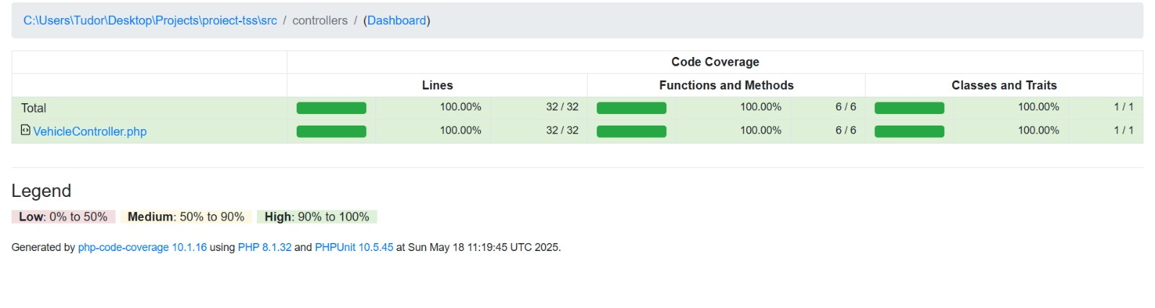
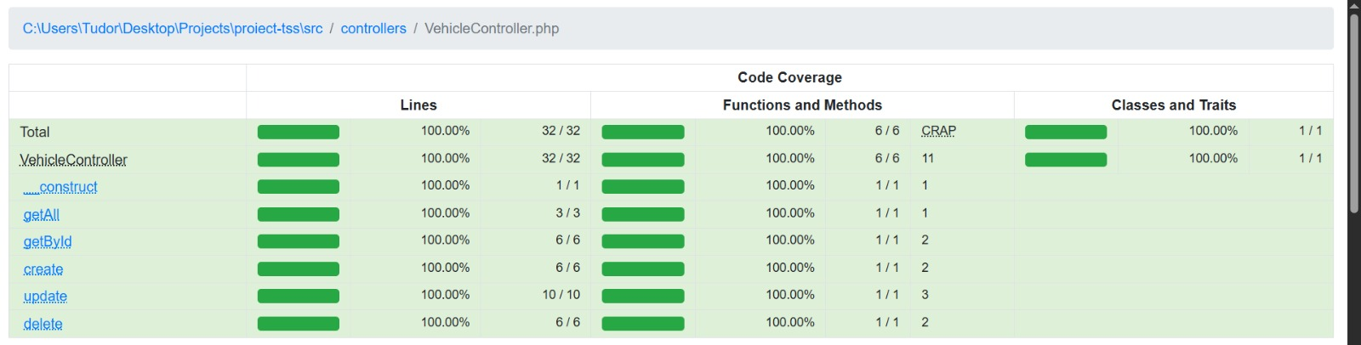
Code coverage

Slide 12
THANK YOU!

